Slide 1
Boosting Algorithm
AdaBoost

Slide 2
AdaBoost
Adaboost is a ensemble method of learning where we make the weaker regressor to train the data
The depth of the tree is limited
We get strong model by combining the weak models

Slide 3
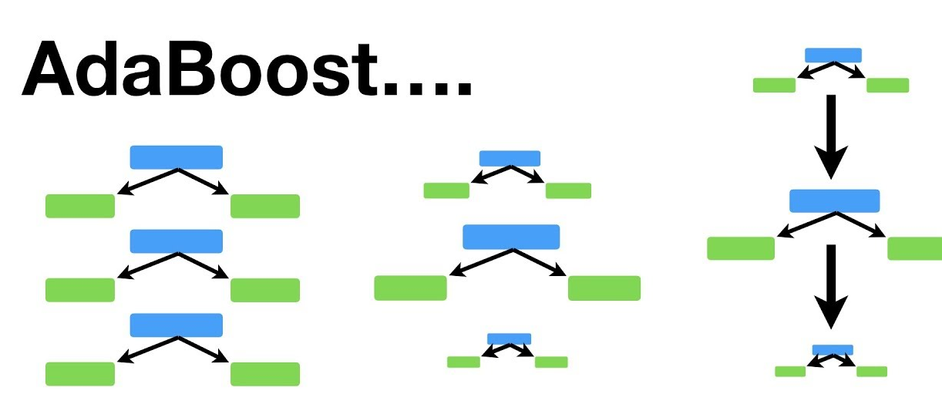
AdaBoost
Important points
Forest of weak learners
Not all tree are equal
Communicate the error and give weightage

Slide 4
AdaBoost
Model Creation (Regression)
from sklearn.ensemble import AdaBoostRegressor
regressor = AdaBoostRegressor(n_estimators=50, learning_rate=0.1, random_state=0)

Slide 5
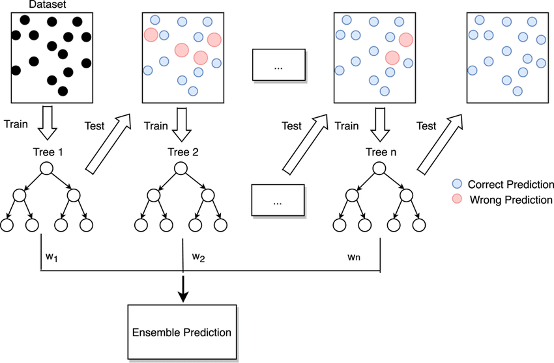
XG Boosting
Gradient Boosting follow a method where it optimize the loss function of the model and improves sequentially

Slide 6
XG Boosting
XG Boosting works same as gradient boosting but it has additional functionality called Distributed Machine Learning process
more computational speed and model efficiency

Slide 7
XG Boost
Model Creation of XG Boost
Regression
from xgboost import XGBRegressor
regressor=XGBRegressor(n_estimators=1000, learning_rate=0.1, max_depth=3)
pip install xgboost, if module is not found

Slide 8
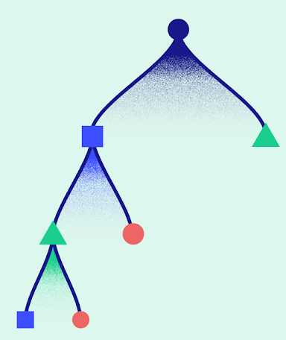
LG Boost
LG Boost can handle larger datasets , poor in small dataset
Leaf Wise Growth

Slide 9
LG Boost
Regression Model:
import lightgbm as lgb
regressor = lgb.LGBMRegressor(learning_rate= 0.1, n_estimators=100, max_depth=3)
pip install lightgbm , if module is not found

